Slide 1
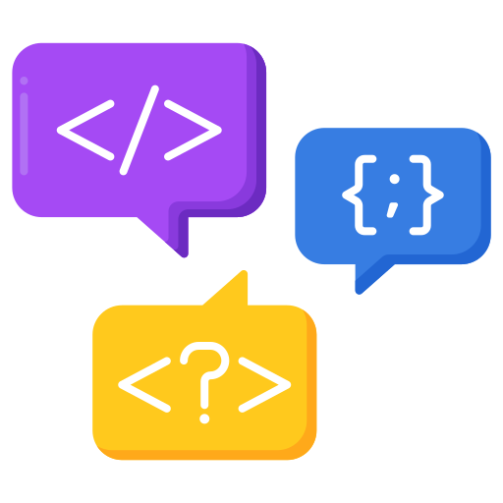
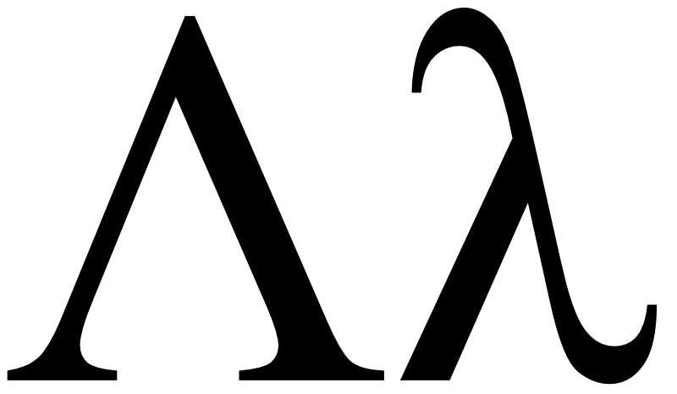
Programming Language Concepts Tutorials
Become a Programming Languages Designer
Supervised by Dr. Kenny Zhu
TAs: Essam Abdelghany

Slide 2
Pop Quiz
Reminder in tutorials we recap on lecture, discuss assignments, discuss project or programming and solve practice problems.

Slide 3

Pop Quiz
1) We learn this course so we can………..
a) Write efficient language translators (e.g., compilers)
b) Understand when to use which language or paradigm
c) Be able to design our own language features
d) Max out our programming skills

Slide 4
Pop Quiz
2) The four principles any language should define……….
a) Syntax, Names, Semantics and Classes
b) Syntax, Functions, Semantics and Types
c) Syntax, Names, Semantics and Types
d) Syntax, Names, Errors and Types

Slide 5

Pop Quiz
3) The language paradigm that most closely simulates the actual machine……….
a) Imperative
b) OOP
c) Functional
d) Logical

Slide 6
Pop Quiz
4) The purpose of identifying different tokens in a given program……….
a) Statistical purposes
b) Compiler will apply different syntactical rules depending on identifies tokens
c) To be able to spot runtime errors before compilation
d) There is no use. It’s good for intuition.

Slide 7
Pop Quiz
5) Any programming language can be specified represented by……….
a) A single judgement instance
b) A single judgement form
c) A deductive system which is defined as…
d) An inductive hypothesis

Slide 8
Pop Quiz
6) To prove that a judgement form holds for a specific instance, typically we use ……….
a) Bottom-up or top-down derivation
b) Proof by induction
c) Proof by exhaustion
d) Flow charts

Slide 9
Pop Quiz
7) Inductive definitions ……….
a) Can be used to define a property over a set of syntactical of objects
b) Always have two cases
c) Are unique given any judgement
d) Can be used to define a function

Slide 10
Assignment Solution

Slide 11
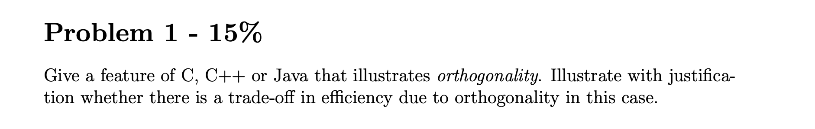
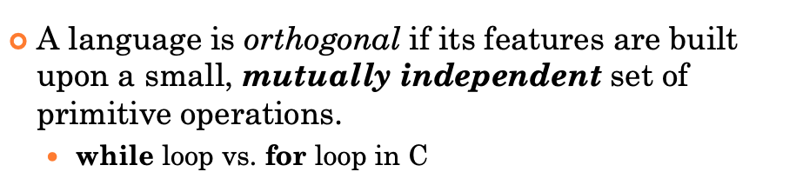
Assignment Solution
Lecture:

Slide 12
Assignment Solution
While Loop VS. For Loop in C:
For loop is implemented as a special case of the while loop:
{
int i = 0;
while (i < 10) {
printf("%d\n", i);
i++;
}
}
>> Orthogonal? Yes.
>> Trade-off in efficiency?

Slide 13
Assignment Solution
Other Solutions:
Operator or function overloading
E.g., no need to define a new operator for “addition over integers”
Solution that is not exactly correct: public vs. private in Java
Or misunderstanding orthogonality in the sense of “independent statements”

Slide 14
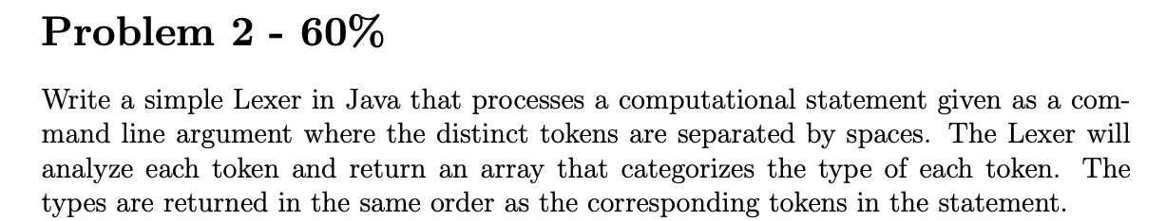
Assignment Solution
Major Comments
Be good to conform with the spec (e.g., output format)
Throwing an error in the try-block is not so meaningful
No need to use regular expressions
You are welcome to present your solution

Slide 15
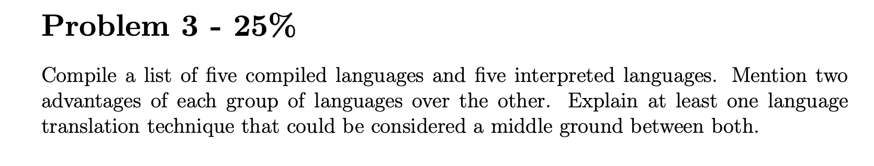
Assignment Solution
Python
JavaScript
C++
C
Rust
Julia
PHP
Erlang
OCaml
R
OCaml
Fortran
GoLang
MatLab
COBOL
Interpreted
Compiled

Slide 16
Assignment Solution
Interpreted Languages | Compiled Languages
Interactive development | Faster once compiled into binary
Easier debugging | Harder to reverse engineer
Easier to implement | Perform further optimization

Slide 17
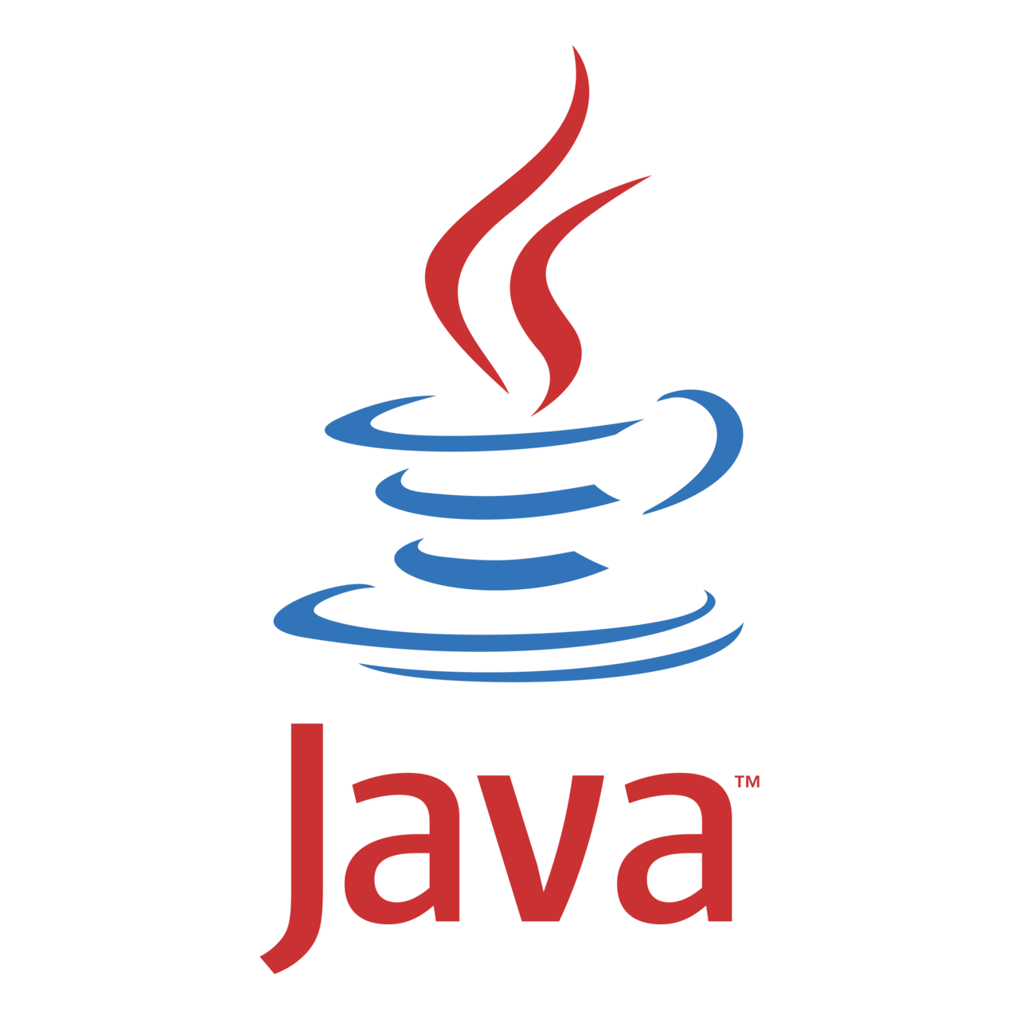
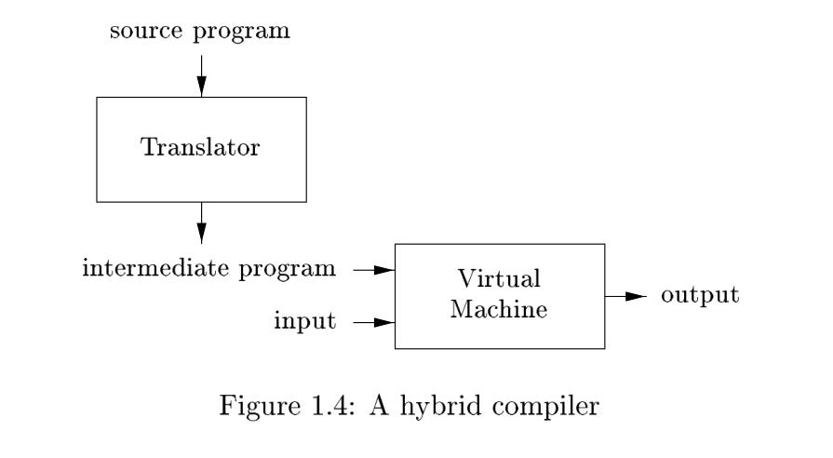
Assignment Solution
Hybrid Compilation
Source: https://dengking.github.io/compiler-principle/1-Introduction/1.1-Language-Processors/

Slide 18
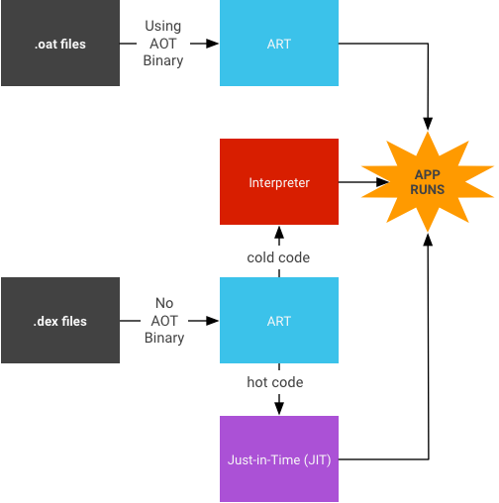
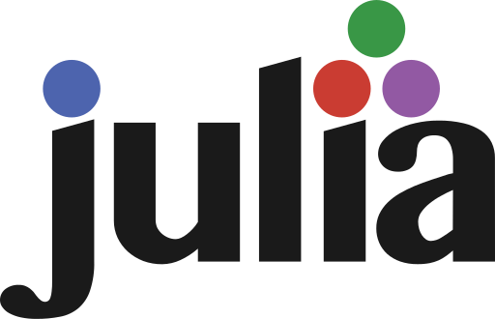
Assignment Solution
Source: https://source.android.com/docs/core/runtime/jit-compiler
Just-in-time Compilation

Slide 19
Thank You

